Slide 1
Online Job Portal
presented by- (Triple Trouble)
Members name:
Faiza Haque Shoily – 22201183
Meher Afroz – 22201176
Jannatul Maowa Meghla - 22201194

Slide 2
Project Description
As more companies are recruiting students for jobs virtually, there is a need for an online Job Portal to connect both job seekers and companies for the recruitment process. The Job Portal would help boost a person’s job seeking efforts and company’s hiring process.

Slide 3
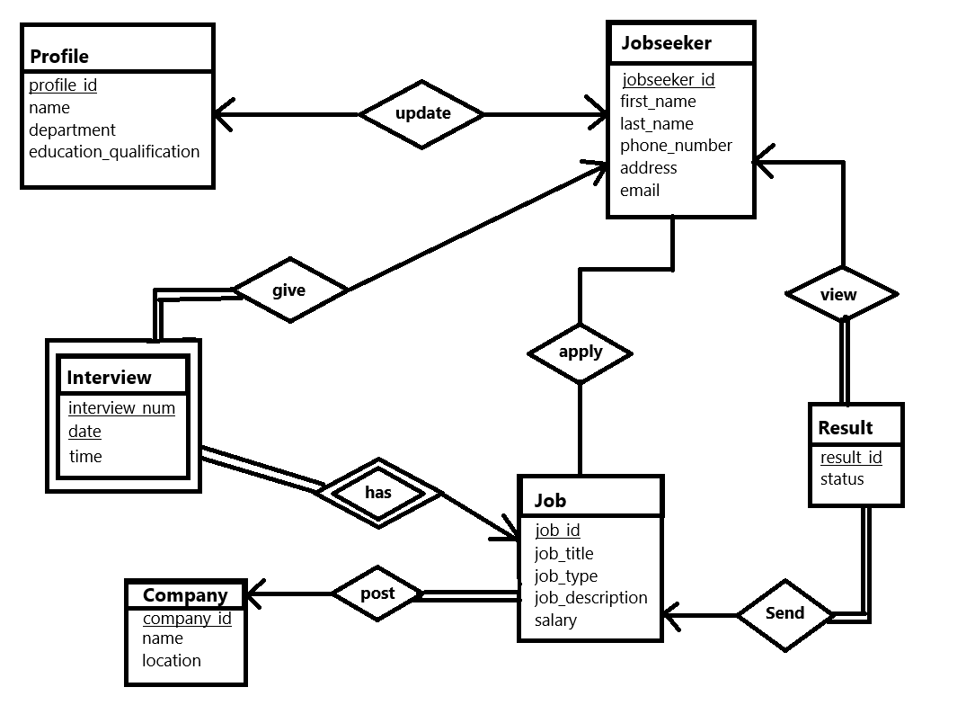
Er- Diagram

Slide 4
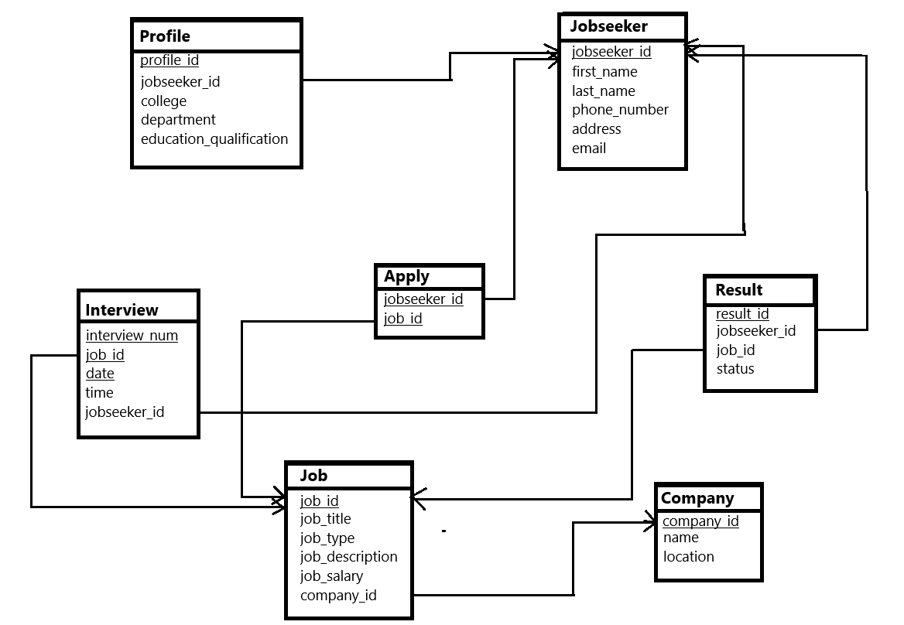
Schema Diagram

Slide 5
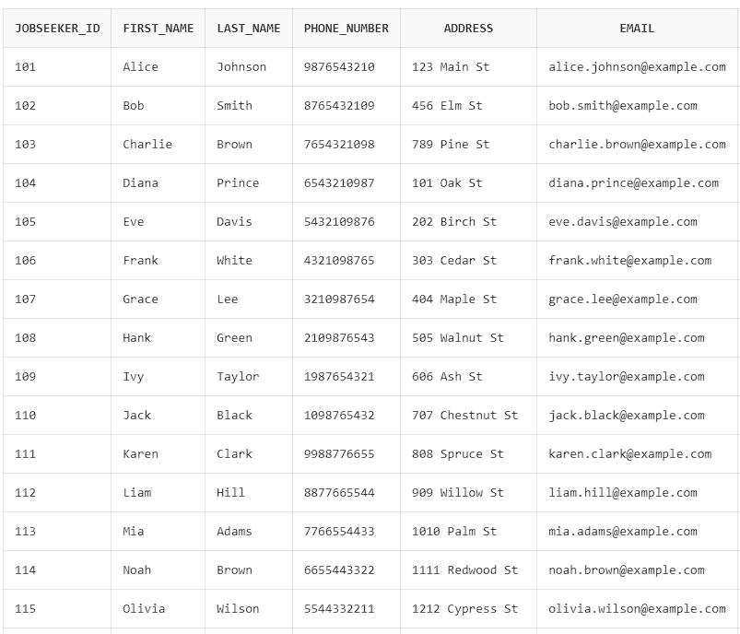
Entities & Attributes
Jobseeker
The jobseeker table is designed to store
information about individuals seeking employment.
It consists of the following columns:
jobseeker_id (INT)(Primary Key).
first_name (VARCHAR2(20))
last_name (VARCHAR2(20))
phone_number (NUMBER)
address (VARCHAR2(20))
email (VARCHAR2(30))
The table is structured to store
essential personal details of job seekers,
including identification, contact information,
and credentials.

Slide 6
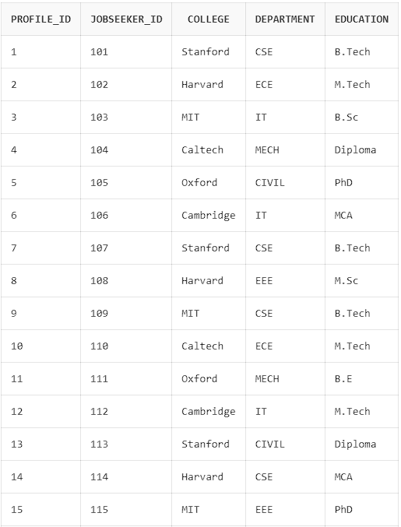
2. Profile
The profile table is designed to store
educational and professional details
of job seekers.
It consists of the following columns:
profile_id (INT)(Primary Key).
jobseeker_id (INT):(Foreign Key).
college (VARCHAR2(20))
department (VARCHAR2(10))
education (VARCHAR2(30)):
The table is used to store additional details
about the job seeker's educational background,
and it is linked to the jobseeker table by the
jobseeker_id.

Slide 7
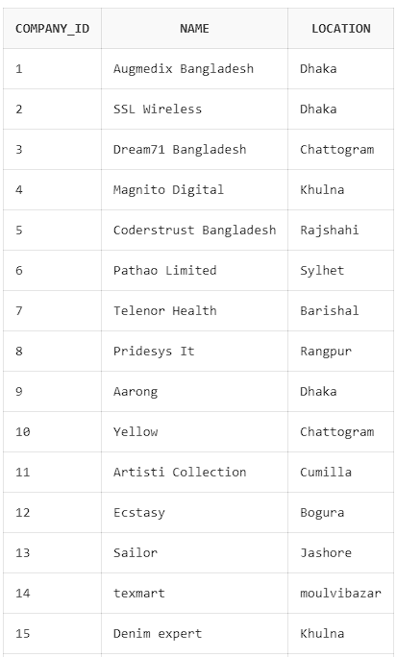
3. Company
The Company table is designed to store information
about companies. It consists of the following columns:
company_id (VARCHAR(20))(Primary Key)
name (VARCHAR(200))
Location (VARCHAR(200))
The table's primary purpose is to store basic
details about each company, with the company_id
serving as a unique identifier. The name and location
columns store the company's name and physical
location, respectively.

Slide 8
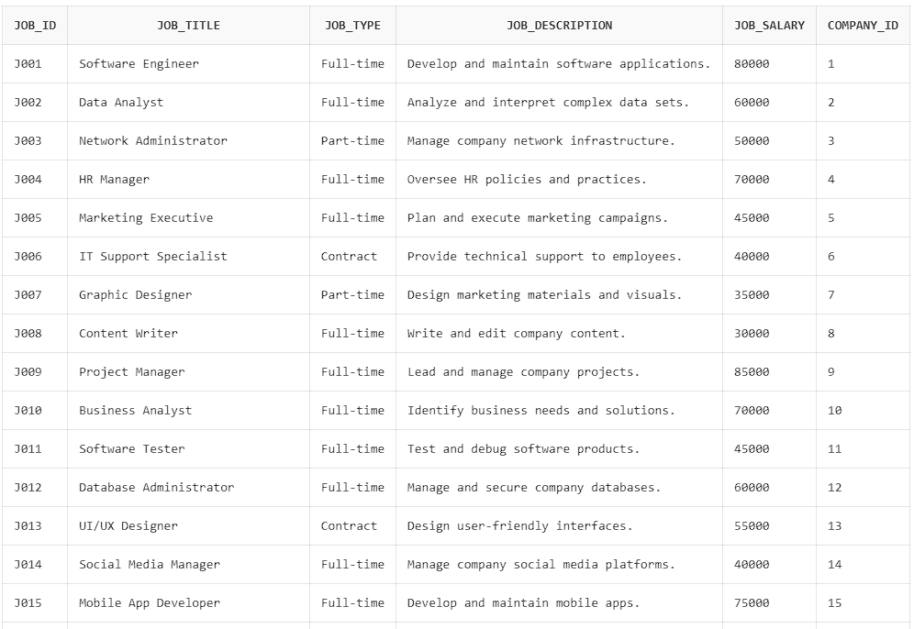
4. Job
The Job table is designed to store information about
job listings offered by companies. It consists of the
following columns:
job_id (VARCHAR(20))(Primary Key)
job_title (VARCHAR(400))
job_type (VARCHAR(200)) job_description (VARCHAR(2000))
job_salary (VARCHAR(30))
company_id (VARCHAR(20))(Foreign Key).
The table stores job-specific details
and links each job listing to a company
through the company_id foreign key.
This relationship ensures that each job listing
is associated with the relevant company.

Slide 9
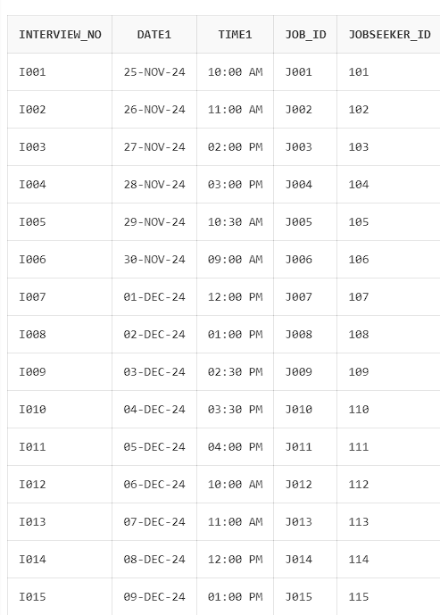
5. Interview
The Interview table is designed to store information
about interview schedules for job seekers. It consists
of the following columns:
Interview_no (VARCHAR(50)): (Primary Key).
date (VARCHAR(20)): ( Primary Key).
time (VARCHAR(50)):
job_id (VARCHAR(20)): (Foreign Key).
jobseeker_id (INT): (Foreign Key).
The table's primary purpose is to store interview
details, including the interview identifier, date, time,
and the associated job and job seeker. The Interview_no
and date and job_id together form the composite primary key,
ensuring that each interview is uniquely identified by
its number and date. The table also establishes relationships
with the Job and jobseeker tables through foreign keys.

Slide 10
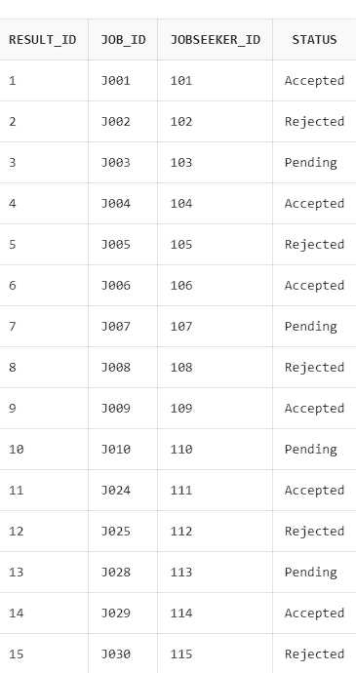
6. Result
The Result table is designed to store the outcome of job
interviews for job seekers. It consists of the following columns:
result_id (INT): (Primary Key).
job_id (VARCHAR(50)): (Foreign Key).
jobseeker_id (INT): (Foreign Key).
status (VARCHAR(20)):
The table tracks the results of interviews, associating
each result with a specific job and job seeker. It links
to the Job and jobseeker tables through foreign keys,
allowing the status of an interview to be recorded and
tracked for each job seeker and job.

Slide 11
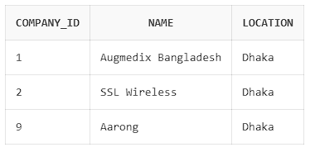
Queries
Find company based on a specific location:
select * from company where location = 'Dhaka';

Slide 12
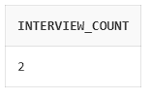
2. Get the Number of Interviews Scheduled for a Job:
select count(*) as interview_count
from Interview
where job_id = 'J001';

Slide 13
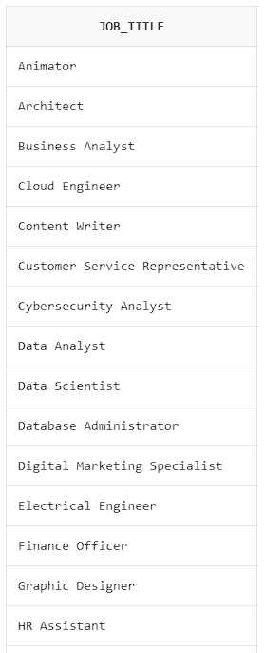
3. job_title ordered alphabetically in ascending order:
select job_title from Job
order by job_title asc;

Slide 14
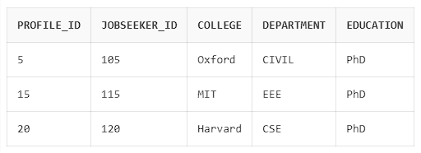
4. Find the jobseekers who are PhD holders:
select * from profile where education = 'PhD’;

Slide 15
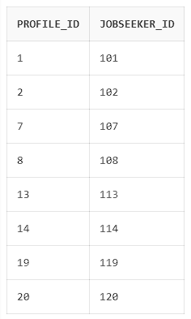
5. Find profile id’s who are from Stanford and Harvard University:
select profile_id, jobseeker_id
from profile
where college = 'Stanford' or college = 'Harvard';

Slide 16
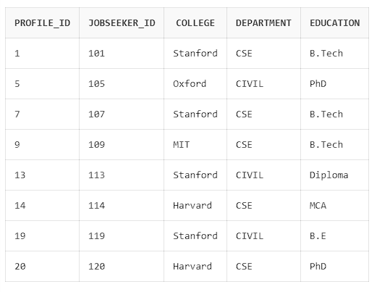
6. Find profiles who are from CSE and CIVIL department:
select * from profile
where department in ('CSE', 'CIVIL');

Slide 17
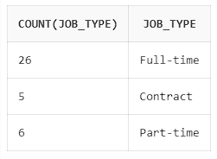
7. Find how many Full-Time, Half-Time,Contract job is available:
select count (job_type) , job_type
from job group by job_type;

Slide 18
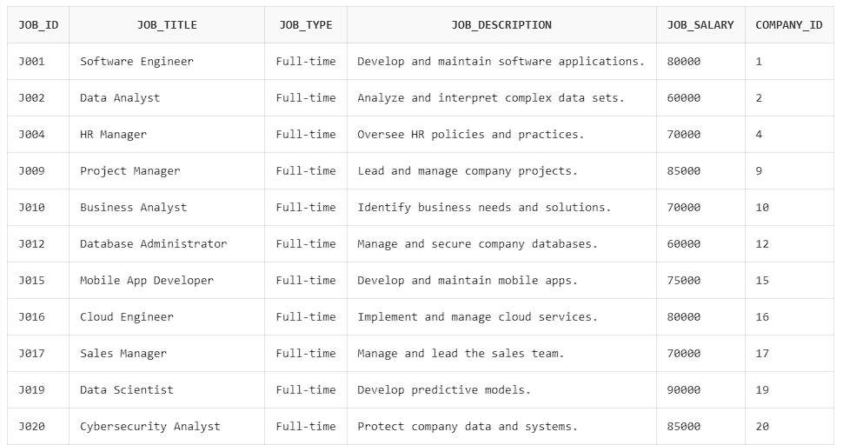
8. Find Full Time jobs with salary greater than 50000 :
select * from job where job_type = 'Full-time' and job_salary > 50000;

Slide 19
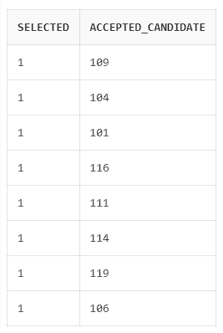
9. Find how many candidates are accepted and their jobseeker id’s for a job :
select count (jobseeker_id) as selected , jobseeker_id as Accepted_Candidate
from result
where status = 'Accepted' group by jobseeker_id;

Slide 20
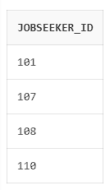
10. Find Job Seekers Who Have Applied for a Specific Job:
select jobseeker_id from Apply
where job_id = 'J001';

Slide 21
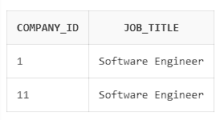
11. Find All Companies Hiring for a Specific Job Title:
select c.company_id, j.job_title
from Company c join Job j on c.company_id = j.company_id
where j.job_title = 'Software Engineer';

Slide 22
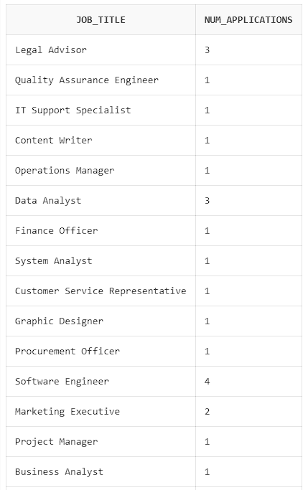
12. Count the Number of Applications for Each Job:
select j.job_title, count(a.jobseeker_id) as num_applications
from Job j join Apply a on j.job_id = a.job_id
group by j.job_title;

Slide 23
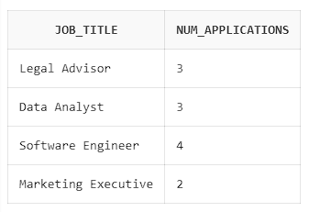
13. Find Job Titles That Have More Than 1 Applications:
select j.job_title, count(a.jobseeker_id) as num_applications
from Job j join Apply a on j.job_id = a.job_id
group by j.job_title having count(a.jobseeker_id) > 1;

Slide 24
Thank You

